Slide 1
17th May, 2019 Single-Cell Omics
Computational practical of Strand-seq Part 1:
From fastq to chromosome overview plot
David, Hyobin Jeong
Korbel Group, Genome Biology, EMBL
Notes:
check if you put all your 2017 lab meeting presentations on the korbel drive under \shared\presentations_group\2016

Slide 2
Processing the Strand-seq library after sequencing
Input: Paired-end fastq files : *_1_sequence.txt.gz *_2_sequence.txt.gz
Step1. Align reads, mark duplicates, add read groups
bwa mem -t {threads} \ -R '@RG\tID:{params.name}\tSM:{SAMPLE_NAME}\tLB:{wildcards.cell}' \ {params.genome} \ {input} \ | samtools view -bT {params.genome} - \ > {output}
bammarkduplicates markthreads={threads} I={input} O={output} index=1 rmdup=0
Step2. Filter & count bins in fixed windows
Rscript {params.qc_plot} {input.counts} {input.info} {output}
Step3. Plots and statistics
Rscript {params.sv_plot} {input} plot_chromosomes/{SAMPLE_NAME}/window_{wildcards.window}
Don’t worry, we can do it with one touch using Snakemake!
Notes:
Single-Cell RNA-Seq Reveals AML Hierarchies Relevant to Disease Progression and Immunity

Slide 3
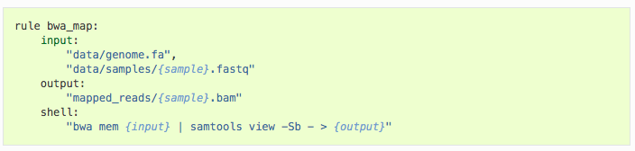
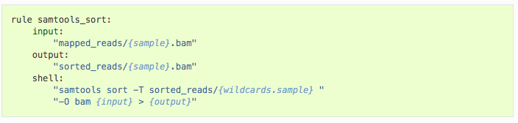
Workflow management with Snakemake
Snakemake is a Python-based workflow management tool
It can run workflows consisting of multiple inter-dependent tasks. These can be computed either locally or on the cluster.
Intermediate results are stored, so the pipeline only executes what is left to do.
See http://snakemake.readthedocs.io or https://bitbucket.org/snakemake/snakemake/overview
Notes:
Single-Cell RNA-Seq Reveals AML Hierarchies Relevant to Disease Progression and Immunity

Slide 4
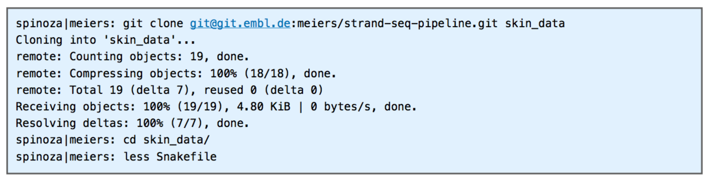
Step1: Download and install the pipeline
https://git.embl.de/meiers/strand-seq-pipeline
It’s stored in an in-house git code repository https://git.embl.de/
Notes:
Single-Cell RNA-Seq Reveals AML Hierarchies Relevant to Disease Progression and Immunity

Slide 5
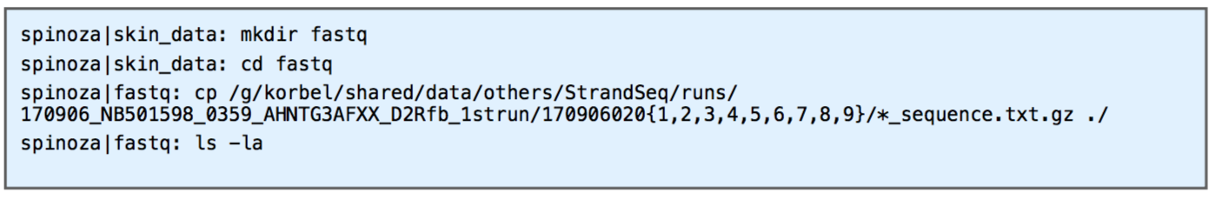
Step2: Add sequencing data to the pipeline
Tell the pipeline which data to use by copying/linking files into a fastq subdirectory
Strand-seq raw data is stored here:
/g/korbel/shared/data/others/StrandSeq
Strand-seq analysis data is typically stored on
/g/korbel2/StrandSeq
Below, we copy only a subset of cells (01-09) to keep compute times low
We will start with 10 cells from RPE-1 C7
Notes:
Single-Cell RNA-Seq Reveals AML Hierarchies Relevant to Disease Progression and Immunity

Slide 6
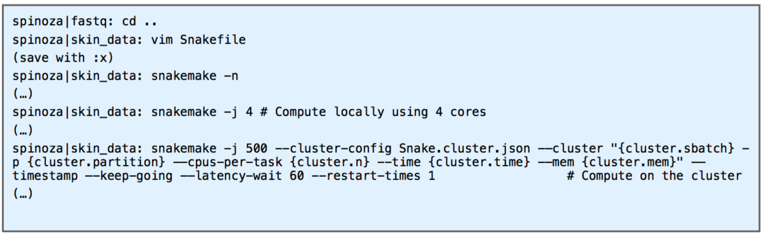
Step3: Set the sample and execute the pipeline
Edit the Snakemake file to specify the sample name and potentially other variables.
Using snakemake -n you can see which jobs are going to be computed. Run snakemake locally or on the cluster.
Notes:
Single-Cell RNA-Seq Reveals AML Hierarchies Relevant to Disease Progression and Immunity

Slide 7
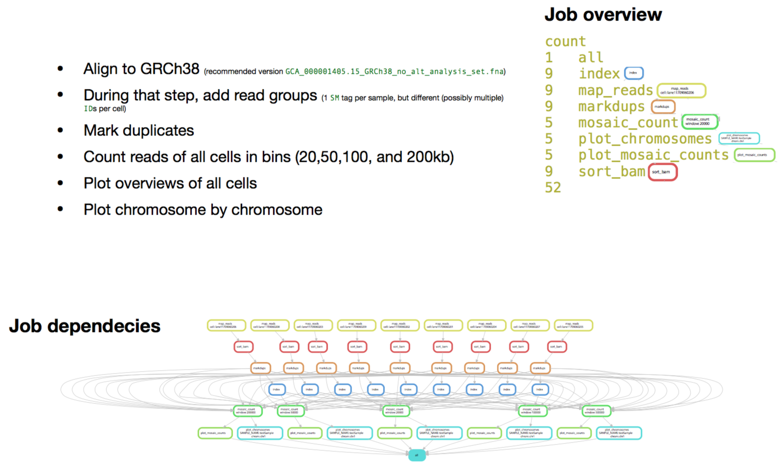
What will be happened in the pipeline?

Slide 8
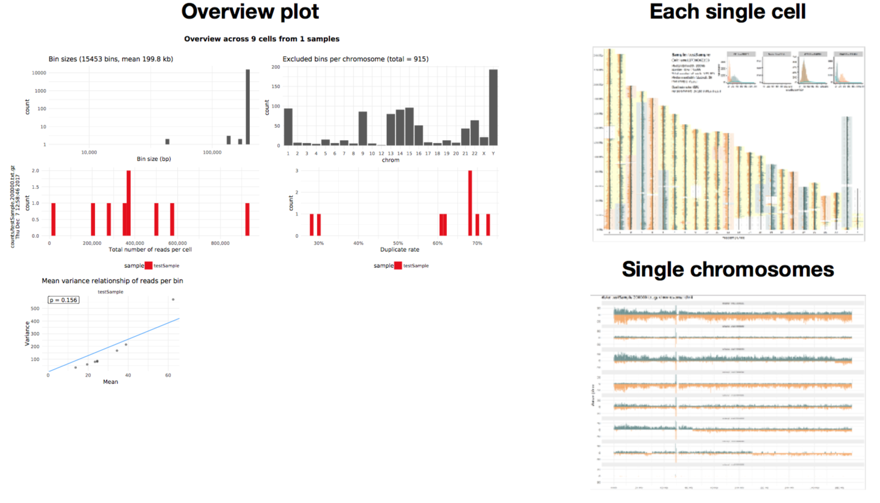
Output of the pipeline
Three different plots for quality checking and first look for the SVs
Bam files from this pipeline will be used as an input of downstream advanced analysis

Slide 9
Challenges
Repeat the process with 10 cells from the RPE-1 BM510 cell line
Compare the RPE-1 C7 and BM510 overview plot, which SVs are in common, and which SVs are specific to BM510 or C7?
RPE1-WT
RPE1-C7
RPE1-BM510

